Slide 1

TEAM 62
General Manager Dashboards
Prototypes

Slide 2

General Manager Insights
Team Roster
Player Stats
Team 62

Slide 3
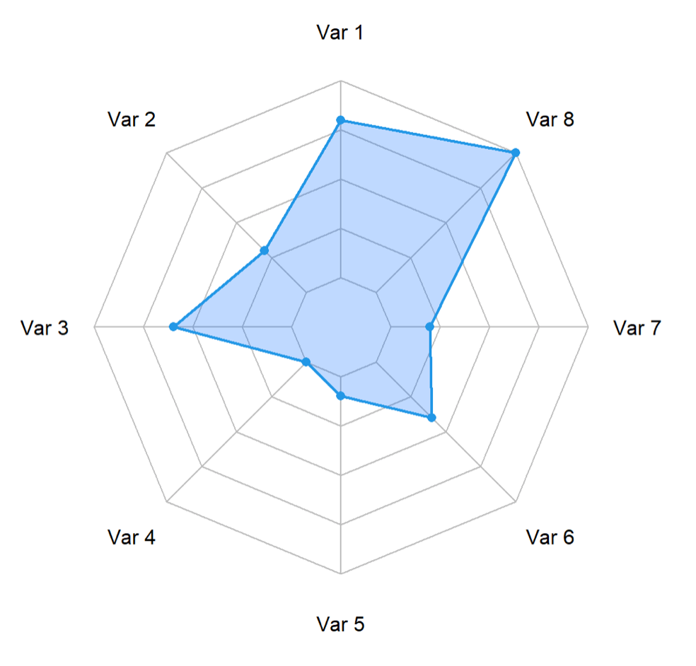
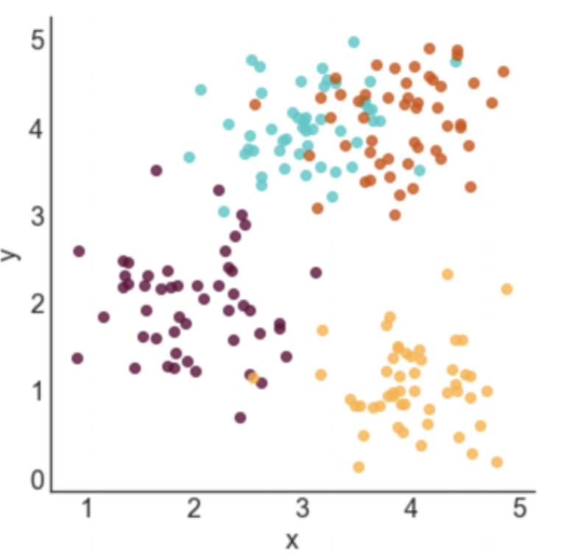
Team Roster
Recommended Starters
Starting Lineup
Player | Stat 1 | Stat 2 | Stat 3 | Stat 4
Player 1 | .385 | 25 | .126 | .256
Player 2 | .165 | 12 | .465 | .356
Filter 1
Filter 2
Bullpen Rotation
Filter 3
Filter 4
Player | Stat 1 | Stat 2 | Stat 3 | Stat 4
Player 1 | .385 | 25 | .126 | .256
Player 2 | .165 | 12 | .465 | .356
Team Cluster Analysis
Bench Players
Player | Stat 1 | Stat 2 | Stat 3 | Stat 4
Player 1 | .385 | 25 | .126 | .256
Player 2 | .165 | 12 | .465 | .356
Team 62

Slide 4
Team Roster
Recommended Starters
Starting Lineup
We’ll have to determine which metrics to pass through to our LP model, such as creating a starting lineup based on maximizing OBP, RBIs, while meeting position constraints.
We’ll have to determine relevant metrics to gauge in a radar chart
Player | Stat 1 | Stat 2 | Stat 3 | Stat 4
Player 1 | .385 | 25 | .126 | .256
Player 2 | .165 | 12 | .465 | .356
Filter 1
We’ll need to determine which filters are relevant across all metrics, such as excluding injured players.
Filter 2
Bullpen Rotation
Filter 3
This is where knowing which pitcher pitched earlier in the week and number of pitches they threw could be helpful.
Filter 4
Player | Stat 1 | Stat 2 | Stat 3 | Stat 4
Player 1 | .385 | 25 | .126 | .256
Player 2 | .165 | 12 | .465 | .356
Team Cluster Analysis
Maybe we can perform a cluster analysis on either:
All Players in the MLB
Players on the Team
Starting Lineup vs. Bench
Team level cluster
Bench Players
Non-Starters who a GM can toggle into the starting lineup and relevant model metrics.
Player | Stat 1 | Stat 2 | Stat 3 | Stat 4
Player 1 | .385 | 25 | .126 | .256
Player 2 | .165 | 12 | .465 | .356
Team 62

Slide 5
Player Stats
Filter 1
Filter 2
Filter 3
Filter 4
Team 62

